Slide 1
British AIRWAYS REVIEWS ANALYSIS

Slide 2
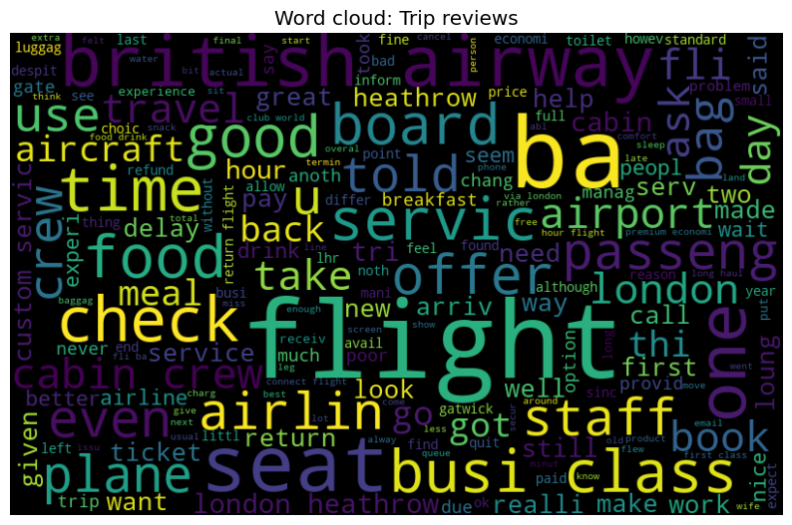
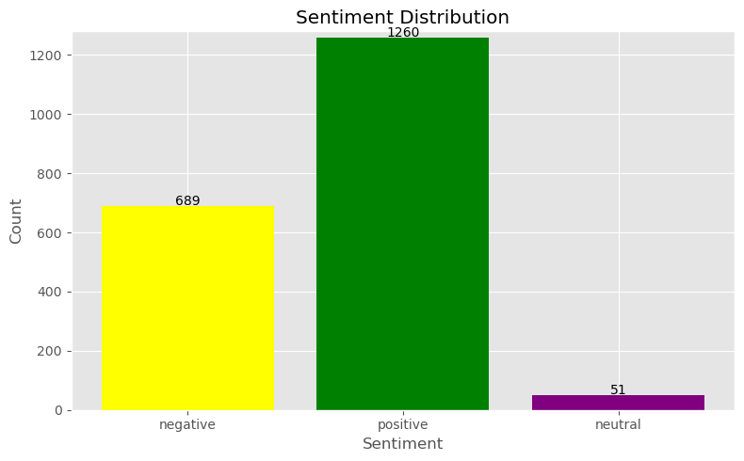
Results
Flight, food, airline, time, staff, business class, seat, services, cabin crew, ba, delay, return are words mostly used by reviewers.
Passengers are not happy about the delays in flights.
The reviews are specifically from passengers that board from or to London Heathrow airport.
Passengers had a variety of experiences considering the 'good' and 'bad' experiences expressed by passengers.
Most reviewers expressed satisfaction on their experience with British airways flights.
However, there is still a significant amount of negative feedback that needs to be addressed to enhance customer satisfaction.
Most reviewers tend to express clear positive or negative opinion about their experience.

